Slide 1
Presentation brief for MCT’s
Title of presentation | Data Exploration and Transformation in Azure Databricks
Presentation\Lab length | Presentation: 50 - 60 minutes Lab: 50 – 60 minutes
Audience | Data Engineers, Data Scientists, Data Professionals, Data Architects, BI Professionals, Developers
Purpose | Understand Azure Databricks Read and write data in Azure Databricks Work with DataFrames in Azure Databricks Work with DataFrames advanced methods in Azure Databricks
(think) Student key takeaways | The student should understand data engineering concepts using Azure Databricks The student should understand how to read and write data in Azure Databricks The student should be able to be familiar with data transformation techniques with DataFrames in Azure Databricks The student should comprehend the data exploration techniques using DataFrames in Azure Databricks
(feel) Student desired mindset | The student may feel confusion about the difference between an Apache Spark Notebook and the notebook experience in Azure Databricks. The student may feel confusion in relation to the use of a Spark Pool and setting up an Azure Databricks Cluster The student may feel they are not familiar with DataFrames, PySpark or SparkSQL and may need help understanding the code in the lab
(do) Student outcomes | The student should be able to articulate data exploration techniques using DataFrames in Azure Databricks. The student should be able to understand how to read and write data in Azure Databricks The students should be able to work with DataFrames and data transformation in Azure Databricks
More information | For MCT course feedback, visit the Microsoft Official Courseware forum
Notes:
Instructor notes and guidance.
This slide is for MCT use only, outlining the aims and objectives of this module.

Slide 2
DP-203T00: Data Exploration and Transformation in Azure Databricks
Notes:
Instructor notes and guidance.
Introduce to the students that this module explores data and deep dives into data transformations using Azure Databricks. First, you should explain the capabilities of Azure Databricks and create an understanding of what Azure Databricks entails.
Second, you will dive into reading and writing data in Azure Databricks and the various techniques to do so. Third, you will give an initial introduction to working with DataFrames in Azure Databricks, where the focus lies on the usage of the Apache Spark DataFrame API and some basic transformations. Fourth, you will deep-dive into transformations using DataFrames, where advanced methods such as DataTime manipulations will be discussed.
In the lab, we take to opportunity to explore how to use various Apache Spark DataFrame methods to explore and transform data in Azure Databricks. The student will learn how to perform standard DataFrame methods to explore and transform data. The student will also learn how to perform more advanced tasks, such as removing duplicate data, manipulate date/time values, rename columns, and aggregate data.

Slide 3

Agenda
Lesson 01 – Understand Azure Databricks
Lesson 02 – Read and write data in Azure Databricks
Lesson 03 – Work with DataFrames in Azure Databricks
Lesson 04 – Work with DataFrames advanced methods in Azure Databricks
Notes:
Instructor notes and guidance.
This space has been left deliberately blank.

Slide 4
Lesson 01: Understand Azure Databricks
Notes:
Instructor notes
This space has been left deliberately blank

Slide 5
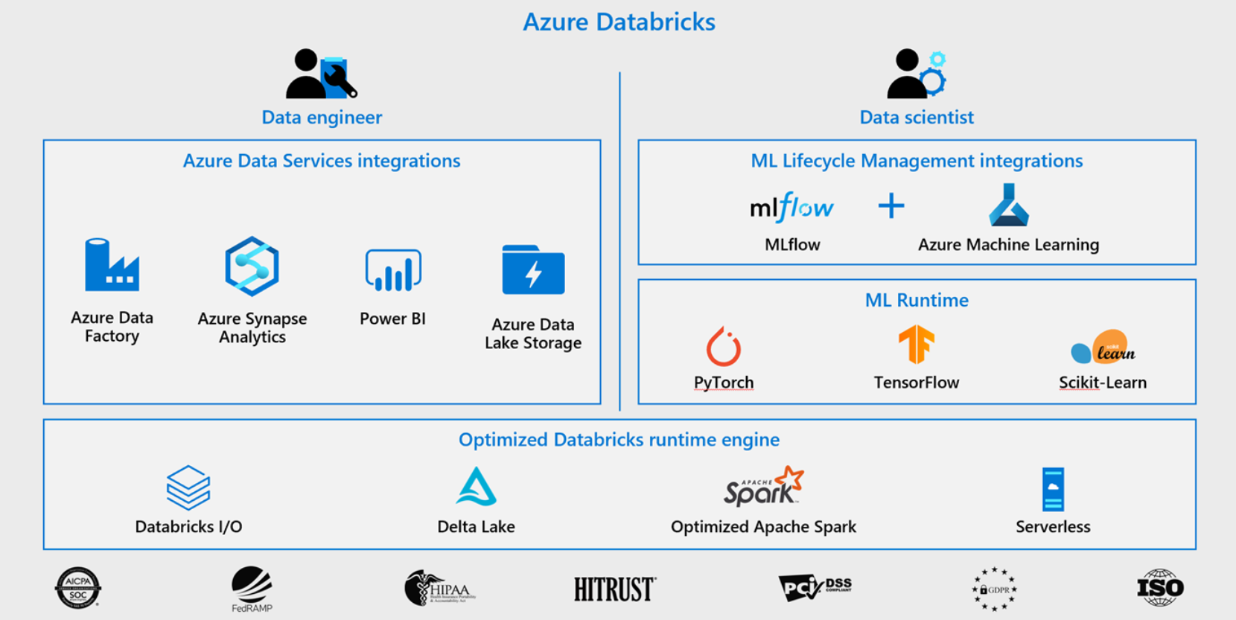
Understand Azure Databricks
Notes:
Talking points
Azure Databricks is a fully-managed, cloud-based Big Data and Machine Learning platform, which empowers developers to accelerate AI and innovation by simplifying the process of building enterprise-grade production data applications. It integrates with Azure Data services which a Data Engineer should be familiar with. These services could include Azure Data Factory, Azure Synapse Analytics, Power BI and Azure Data Lake Storage.
Built as a joint effort by the team that started Apache Spark and Microsoft, Azure Databricks provides data engineering teams with a single platform for Big Data processing. It is also used by Data scientists as a platform to build their machine learning models.
Azure Databricks uses an optimized Databricks runtime engine, to provide an end-to-end managed Apache Spark platform optimized for the cloud, whilst having the benefits of the enterprise scale and security of the Microsoft Azure platform. Azure Databricks makes it simple to run large-scale data engineering Spark workloads.
Azure Databricks, as a compute engine, sits at the center of your Azure-based software platform and provides native integration with Azure Active Directory (Azure AD) and other Azure services. Azure Databricks is optimized from the ground up, with a focus on performance and cost-efficiency in the cloud. Since the core engine of Azure Databricks runs on Spark, it enables you to analyze big data using Scala, Python Java, R or SQL, and develop machine learning models, process graphs, and analyze real-time data streams.
Instructor notes and guidance.
This slide gives an overview of the Azure Data Services integrations with Azure Databricks. It also provides you with an overview of the optimized Databricks runtime engine and the different roles that are meant to be using Azure Databricks.
Call out to the students, that in the lab for this module, they will experience working with notebooks in Azure Databricks and create an understanding of DataFrames. This is only one aspect of Azure Databricks and they will cover more in later modules.
Related Module:
Module 15: Create a Stream Processing Solution with Event Hubs and Azure Databricks
Recommended reading for this slide
https://docs.microsoft.com/en-us/learn/modules/describe-azure-databricks/

Slide 6
Lesson 02: Read and write data in Azure Databricks
Notes:
Instructor notes
This space has been left deliberately blank

Slide 7
Read and write data in Azure Databricks
Multiple format support
Reading data from CSV, PARQUET, JSON and many others
Integrated with several Azure Data Services
Reading and writing from and to Azure Data Lake Storage, Azure Synapse Analytics, etc.
Notebook experience
Reading and writing by simply writing code in a shared notebook experience
Notes:
Talking points
You can use Azure Databricks in order to read multiple file types, both with and without a Schema. You can read and write from various formats such as CSV, Parquet, and JSON.
In addition to that, Azure Databricks can combine inputs from files and data stores, such as Azure SQL Database, Azure Data Lake storage, and Azure Synapse Analytics.
Within the notebook experience of Azure Databricks, you have multiple language support in order to read and write data by using code your prefer. This is typically perform against an object known as a DataFrame.
You could view DataFrames as you might see data in Microsoft Excel. It's like a box with squares in it, that organizes data, which we could also refer to as a table of data. It is a single set of two-dimensional data that can have multiple rows and columns in the data. Each row, is a sample of data. Each column is a variable or parameter that is able to describe the data.
What would happen though, if you have thousands and thousands boxes?
A DataFrame creates a data structure and it's one of the core data structures in Spark. In Spark, a DataFrame is seen as a distributed collection of data that is organized into columns that have names. As you start reading or loading data that is unstructured, semi-structured, or structured. A DataFrame can start transforming that data in order to gain insights. You can use different languages that have different functionalities, like using Spark SQL, PySpark, and others to read and manipulate the data as you require.
Instructor notes and guidance
This slide focusses on reading and writing data and the ease to do so in Azure Databricks, as some customers already use Azure Databricks. Call out to the students, that in the lab for this module, they will experience working with Azure Databricks and how reading and writing data with the use of DataFrames works within Azure Databricks.
A related module in this course is for streaming with Azure Databricks, which can be found here:
Module 11: Create a Stream Processing Solution with Event Hubs and Azure Databricks
Recommended reading for this slide
Read and write data in Azure Databricks - Learn | Microsoft Docs

Slide 8
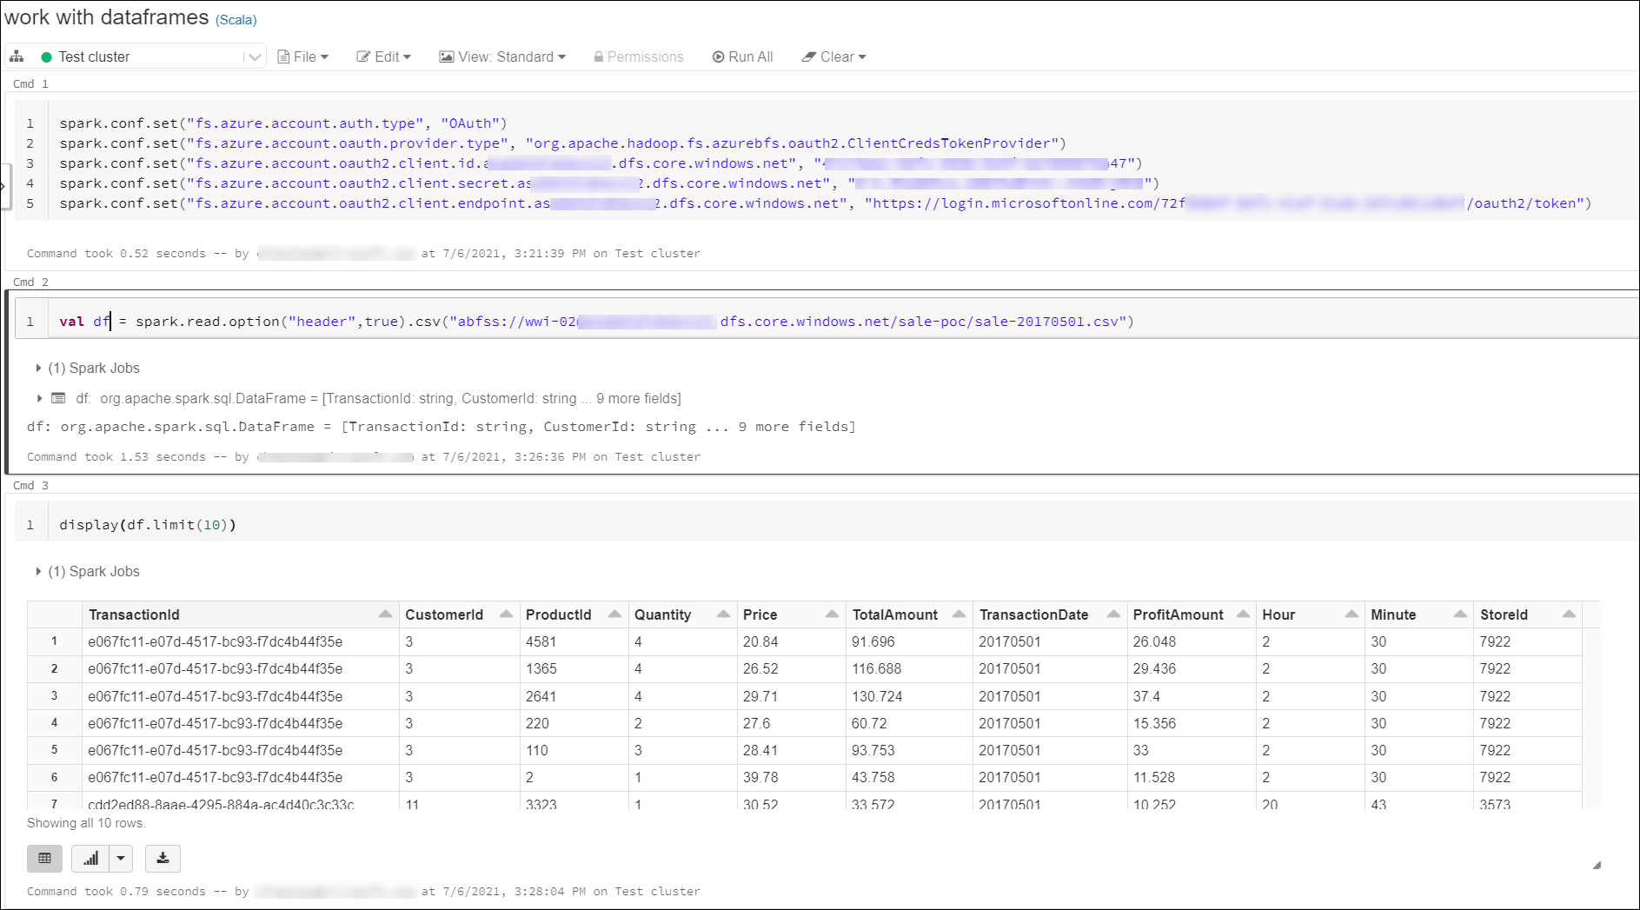
Read data in Azure Databricks
Notes:
Talking points
Go through the three steps that would be required to initiate the reading of data in Azure Databricks
Connect to the underlying data store as shown in cell 1
Create the data frame as shown in cell 2
Display the data frame results as shown in cell 3
Instructor notes and guidance.
Explain to the students that the example on the screen is using Scala, but this can be performed using other languages such as Python
Recommended reading for this slide
https://docs.microsoft.com/en-us/learn/modules/read-write-data-azure-databricks/

Slide 9
Working with Select in Azure Databricks
SQL | DataFrame (Python)
SELECT col_1 FROM myTable | df.select(col("col_1"))
DESCRIBE myTable | df.printSchema()
SELECT * FROM myTable WHERE col_1 > 0 | df.filter(col("col_1") > 0)
..GROUP BY col_2 | ..groupBy(col("col_2"))
..ORDER BY col_2 | ..orderBy(col("col_2"))
..WHERE year(col_3) > 1990 | ..filter(year(col("col_3")) > 1990)
SELECT * FROM myTable LIMIT 10 | df.limit(10)
display(myTable) (text format) | df.show()
display(myTable) (html format) | display(df)
Notes:
Talking points
This slide is intended to show similes between the SQL language with the Python language. Both of which can be used in Azure Databricks. You can use these statement to data select statements in a variety of ways such as
The ability to filter the data by rows and columns
The ability to sort the data using order
Creating aggregate based result sets using group by
Instructor notes and guidance.
The best way to showcase this is to come up with your owns notebooks that can show off some of the capabilities in your preferred language
Recommended reading for this slide
https://docs.microsoft.com/en-us/learn/modules/work-dataframes-azure-databricks/

Slide 10
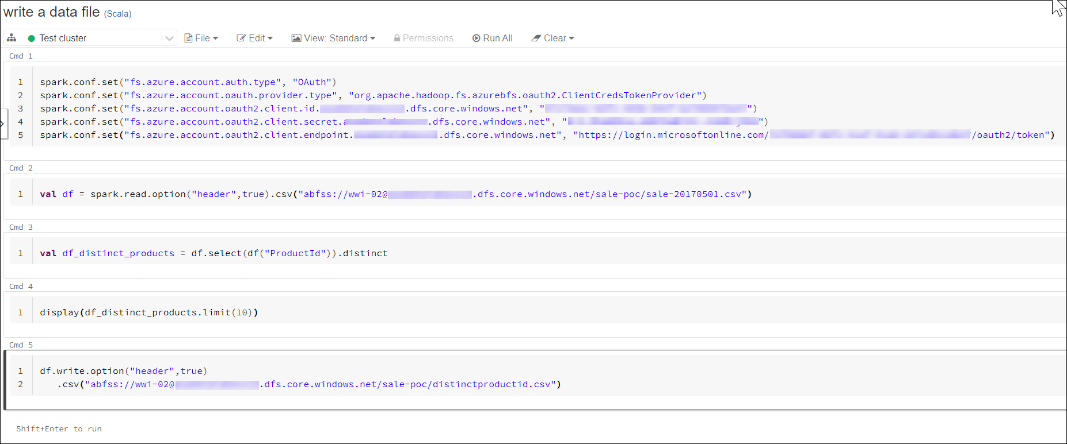
Write data in Azure Databricks
Notes:
Talking points
Go through the steps that would be required to write data in Azure Databricks to an Azure Data Lake
Connect to the underlying data store as shown in cell 1
Create the data frame as shown in cell 2
Manipulate the original DataFrame with a select statement to create a new DataFrame as shown in cell 3
Optionally, you can display the results to validate then select statement as shown in cell 4
Write out the DataFrame results to a file
Instructor notes and guidance.
Explain to the students that the example on the screen is using Scala, but this can be performed using other languages such as Python
Recommended reading for this slide
https://docs.microsoft.com/en-us/learn/modules/read-write-data-azure-databricks/

Slide 11
Lesson 03: Work with DataFrames in Azure Databricks
Notes:
Instructor notes
This space has been left deliberately blank

Slide 12
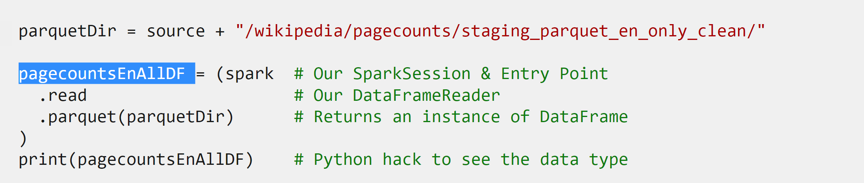
Work with DataFrames in Azure Databricks
Apache Spark DataFrame API reading data in a single command
Notes:
Talking points
General info:
The Apache Spark DataFrame API provides a rich set of functions (select columns, filter, join, aggregate, and so on) that allow you to solve common data analysis problems efficiently. DataFrames also allow you to mix operations seamlessly with custom Python, SQL, R, and Scala code. Within the notebook experience in Azure Databricks, files can be read in a single command, rather then in individual cells
Instructor notes and guidance
This slide depicts code that uses the DataFrame API in Apache Spark within a single command. Above you find an example of a DataFrame called pagecountsEnAllDF (that is highlighted in the graphic) in the code being created, which is using the spark.read method to read a parquet file using the .parquet method
Recommended reading for this slide
Work with DataFrames in Azure Databricks - Learn | Microsoft Docs

Slide 13
Working with transformations in Azure Databricks
Transformations | Description
Select(…) | The select(...) command enables you to specify the columns to include in a query
drop(…) | The drop(...) command enables you to specify the columns you don’t want
distinct(…) | The distinct(…) command returns a distinct set of values in a DataFrame
dropDuplicates(…) | The dropDuplicates(…) command is an alias of the distinct(…) command.
show(…) | The show(..) command is part of the core Spark API and simply prints the results to the console
display(…) | The display(…) command provides more flexibility than show(…) such as downloading results against csv, rendering charts and showing up to 100 rows
limit(…) | The limit(…) command can be used to control the number of records that are returned to a DataFrame
Notes:
Talking points
Many of the transformations listed in the table will instantiate a new DataFrame. The Show and Display transformation will return the results in a DataFrame.
Instructor notes and guidance.
Explain to the students that they will explore all of these transformation options in the lab
Recommended reading for this slide
https://docs.microsoft.com/en-us/learn/modules/work-dataframes-azure-databricks/

Slide 14
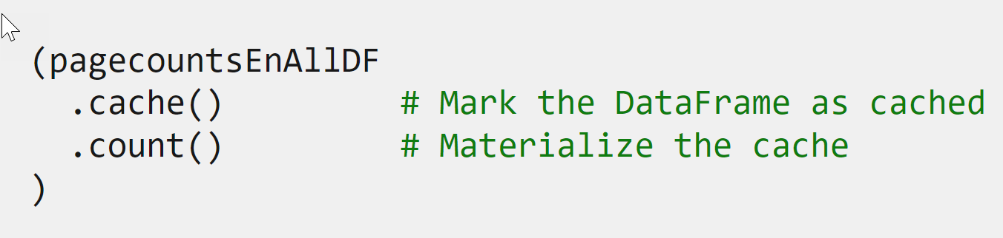
Optimize DataFrames in Azure Databricks
Mix DataFrame operations
Notes:
Talking points
The Apache Spark DataFrame API also provides additional commands that can be used to optimize the performance of the queries that are executed against the DataFrames that are created. Two common options include the cache
Instructor notes and guidance
This slide depicts code that uses the DataFrame API in Apache Spark. Above you find an example of a DataFrame called pagecountsEnAllDF being cached and has a count being performed. Students will work with DataFrames in the lab themselves, and explore what DataFrames look like, how to create one, and how to work with transformations.
Recommended reading for this slide
Work with DataFrames in Azure Databricks - Learn | Microsoft Docs

Slide 15
Lesson 04: Work with DataFrames advanced methods in Azure Databricks
Notes:
Instructor notes
This space has been left deliberately blank

Slide 16
Work with DataFrames advanced methods in Azure Databricks
DateTime manipulation
Enabling different DateTime techniques to use across DataFrames
Aggregate Functions
groupBy() function, sum(), count(), avg(), min(), max() functions
Deduplication of Data
Removing duplicates, by ensuring you only keep 1 record
Notes:
Talking points
There are a number of advanced transformation that can be performed in Azure Databricks, here are some common transformations used:
DateTime manipulation:
Sometimes you need to normalize data where different DateTime formats have been used. Within Azure Databricks, you can use different functions to manipulate DateTime and use it across DataFrames.
Aggregate functions:
Aggregating data is one of the more common tasks when working with big data. When there is a question such as what are the total sales, you might think off using an aggregate function. A common used function is the groupBy() function, which groups the Dataset using the specified columns, so that we can run aggregation on them, we can see the aggregation per grouping. Unlike some other transformations, this transformation does not return a DataFrame. In Scala it returns a RelationalGroupedDataset object and in Python it returns a GroupedData objects. So be mindful these will not be persisted until you store the results in a DataFrame.
Deduplication of Data:
In many scenarios, you will likely get data where there are duplicate records. In some of the records, the names could be mixed case, while in others, they are uppercase, which results in a deduplication of records.
Instructor notes and guidance
This slide showcases some example of advanced transformation methods that are commonly seen among customers. In the lab, students will deep-dive into notebook examples of each of the advanced methods mentioned. The students will use the functions to play with DataTime manipulation, aggregate functions and deduplication functions of data.
Recommended reading for this slide
Work with DataFrames advanced methods in Azure Databricks - Learn | Microsoft Docs

Slide 17
Review questions
Q01 – How do you list files in DBFS within a notebook?
A01 – %fs ls /my-file-path
Q02 – How do you create a DataFrame object?
A02 – Introduce a variable name and equate it to something like myDataFrameDF =
Q03 – You need to find the average of sales transactions by storefront. Which of the following aggregates would you use?
A03 – df.groupBy(col("storefront")).avg("completedTransactions")
Notes:
Instructor notes
This space has been left deliberately blank

Slide 18
Lab: Data Exploration and Transformation in Azure Databricks
Notes:
Instructor notes
This space has been left deliberately blank

Slide 19
Lab overview
This lab teaches you how to use various Apache Spark DataFrame methods to explore and transform data in Azure Databricks. You will learn how to perform standard DataFrame methods to explore and transform data. You will also learn how to perform more advanced tasks, such as removing duplicate data, manipulate date/time values, rename columns, and aggregate data.
Lab objectives
After completing this lab, you will be able to:
Use DataFrames in Azure Databricks to explore and filter data
Cache a DataFrame for faster subsequent queries
Remove duplicate data
Manipulate date/time values
Remove and rename DataFrame columns
Aggregate data stored in a DataFrame
Notes:
Instructor notes
In the lab, we take to opportunity to explore how to use various Apache Spark DataFrame methods to explore and transform data in Azure Databricks. The student will learn how to perform standard DataFrame methods to explore and transform data. The student will also learn how to perform more advanced tasks, such as removing duplicate data, manipulate date/time values, rename columns, and aggregate data.
The following exercises will be performed during the lab:
Use DataFrames in Azure Databricks to explore and filter data
Cache a DataFrame for faster subsequent queries
Remove duplicate data
Manipulate date/time values
Remove and rename DataFrame columns
Aggregate data stored in a DataFrame

Slide 20











Lab 06 Overview
asacosmosdb<unique_suffix>
CosmosDB
Campaign Info
Azure Databricks
asagadatalake<unique_suffix>
Cluster
Azure Data Lake
wwi-02
Sales (parquet)
Customer (csv)
dp203sql<unique_suffix>
SourceDB
Azure Synapse Analytics
Dedicated SQL Pool (SQLPool1)
Built-In Serverless SQL Pool
Apache Spark pool
Pipelines and Dataflows
Power BI
asagaworkspace<unique_suffix>
Notes:
This slide is an optional slide that you can use to show a high-level overview of the technologies used in the lab.
This lab teaches you how to use various Apache Spark DataFrame methods to explore and transform data in Azure Databricks. You will learn how to perform standard DataFrame methods to explore and transform data. You will also learn how to perform more advanced tasks, such as removing duplicate data, manipulate date/time values, rename columns, and aggregate data. They will provision the chosen ingestion technology and integrate this with Stream Analytics to create a solution that works with streaming data.

Slide 21
Lab review
Q01 – What is a function that allows you to print data to the console in Azure Databricks?
Q02 – How can you transform a whole dataset called wholedatasetDF data by selecting only 2 columns?
Q03 – What is a common function to use in order to aggregate data
Notes:
Answers
Question 1 – df.show()
Question 2 - Using the select statement and creating a new DataFrame that consists of only 2 columns by the following statement onlyTwoDF = (wholedatasetDF
.select(“Col1", “Col2“)
Question 3 - The groupBy() function

Slide 22
Module summary
In this module, you have learned about:
Azure Databricks
Transformation Techniques in Azure Databricks
Data exploration techniques
DataFrame methods
Next steps
After the course, consider visiting the website that explores the [Azure Databricks concepts] and architectures where the associated documentation goes more in depth about architectures and concepts related to Azure Databricks.
Notes:
Instructor notes
The next steps is suggested post course learning materials to reinforce what they have learned in the module.

Slide 23
Closing slide
Notes:
Instructor notes
This space has been left deliberately blank

